Slide 1
Analyzing Real-world Job Data with Big Data Analytics
Team:
Partha Nossam
Anusha Rama
Padmanabha Reddy Kottam
Varsha Yelle

Slide 2
Problem Statement
The primary goal of this project to analyze large datasets from real online job postings, with the main goal of improving recruitment strategies for Big Data job roles in the HR department.
Project Objectives:
Identify distinct job families within the real online job postings of Big Data from the provided dataset.
Uncover similar groups of Big Data skills that hold significant value for companies.
Detail the competency levels necessary for each Big Data skill set within each job family

Slide 3
Data Set and Pre-Processing
Dataset:
We have collected more than 21000 big data jobs from various sources like APIFY API (Glassdoor and Indeed Web scraper), Kaggle and Naukari.
Each dataset has different attributes from one another with some common attributes like, Role, Job_Description, Skills, Location and Company.
Pre-Processing:
The only required preprocessing steps for our data involve removing stop words, null values and punctuation; no additional preprocessing is necessary as the data set does not contain much text.
All the four datasets have been merged into single dataset after trimming the unwanted columns like Company_URL, Experience_Level, Salary, Job_type etc.,

Slide 4
Identifying Big Data Job Families
We have used both K- means clustering and N grams analysis separately to identify the similar job roles in the data set.
K-means clustering efficiently groups job titles by multiple features, optimizing quantitative analysis and revealing meaningful patterns in the dataset.
N-gram analysis is effective in extracting common phrases from job titles, revealing insights into language usage and patterns, while being simple and intuitive to implement.

Slide 5
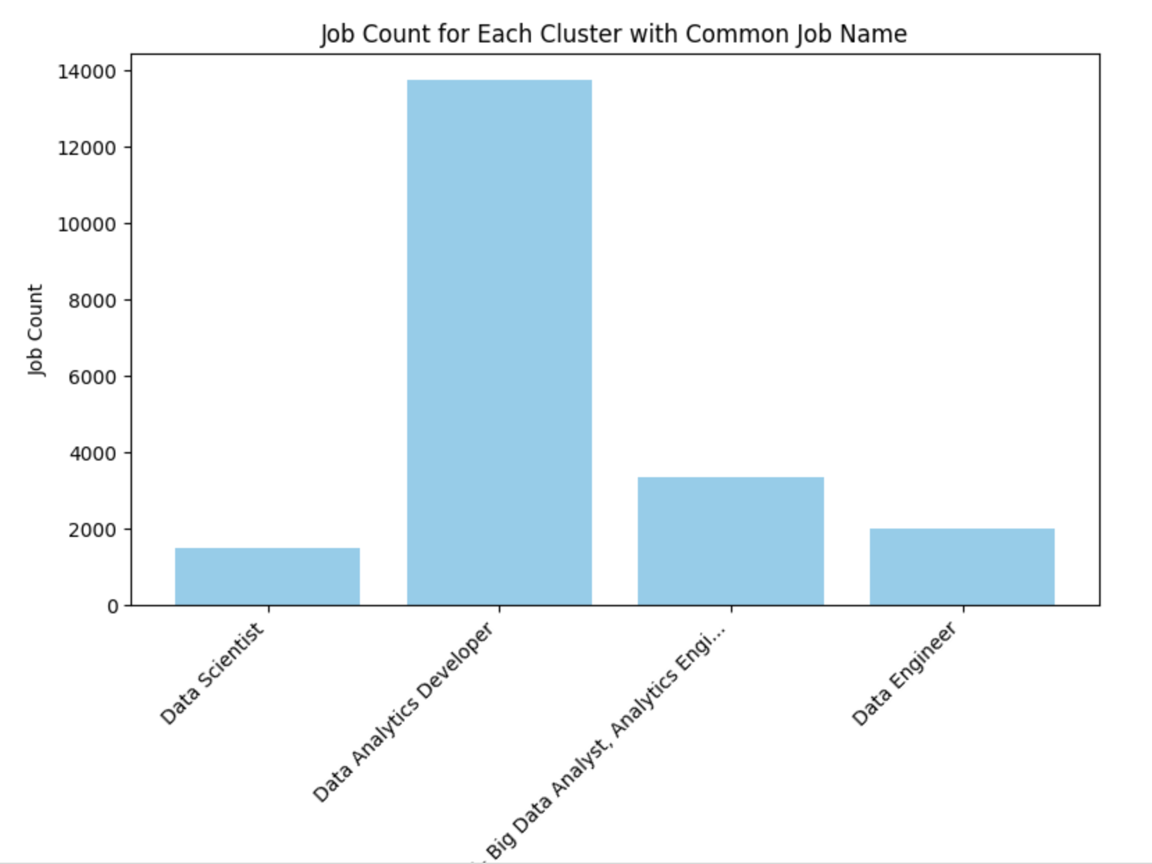
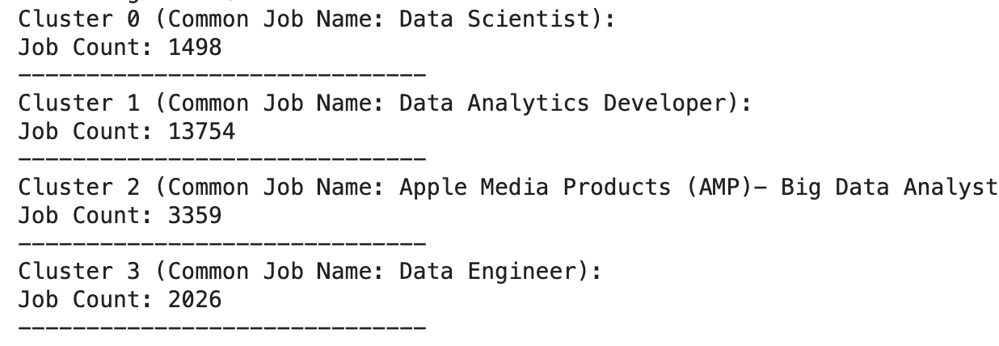
K-means Results:

Slide 6
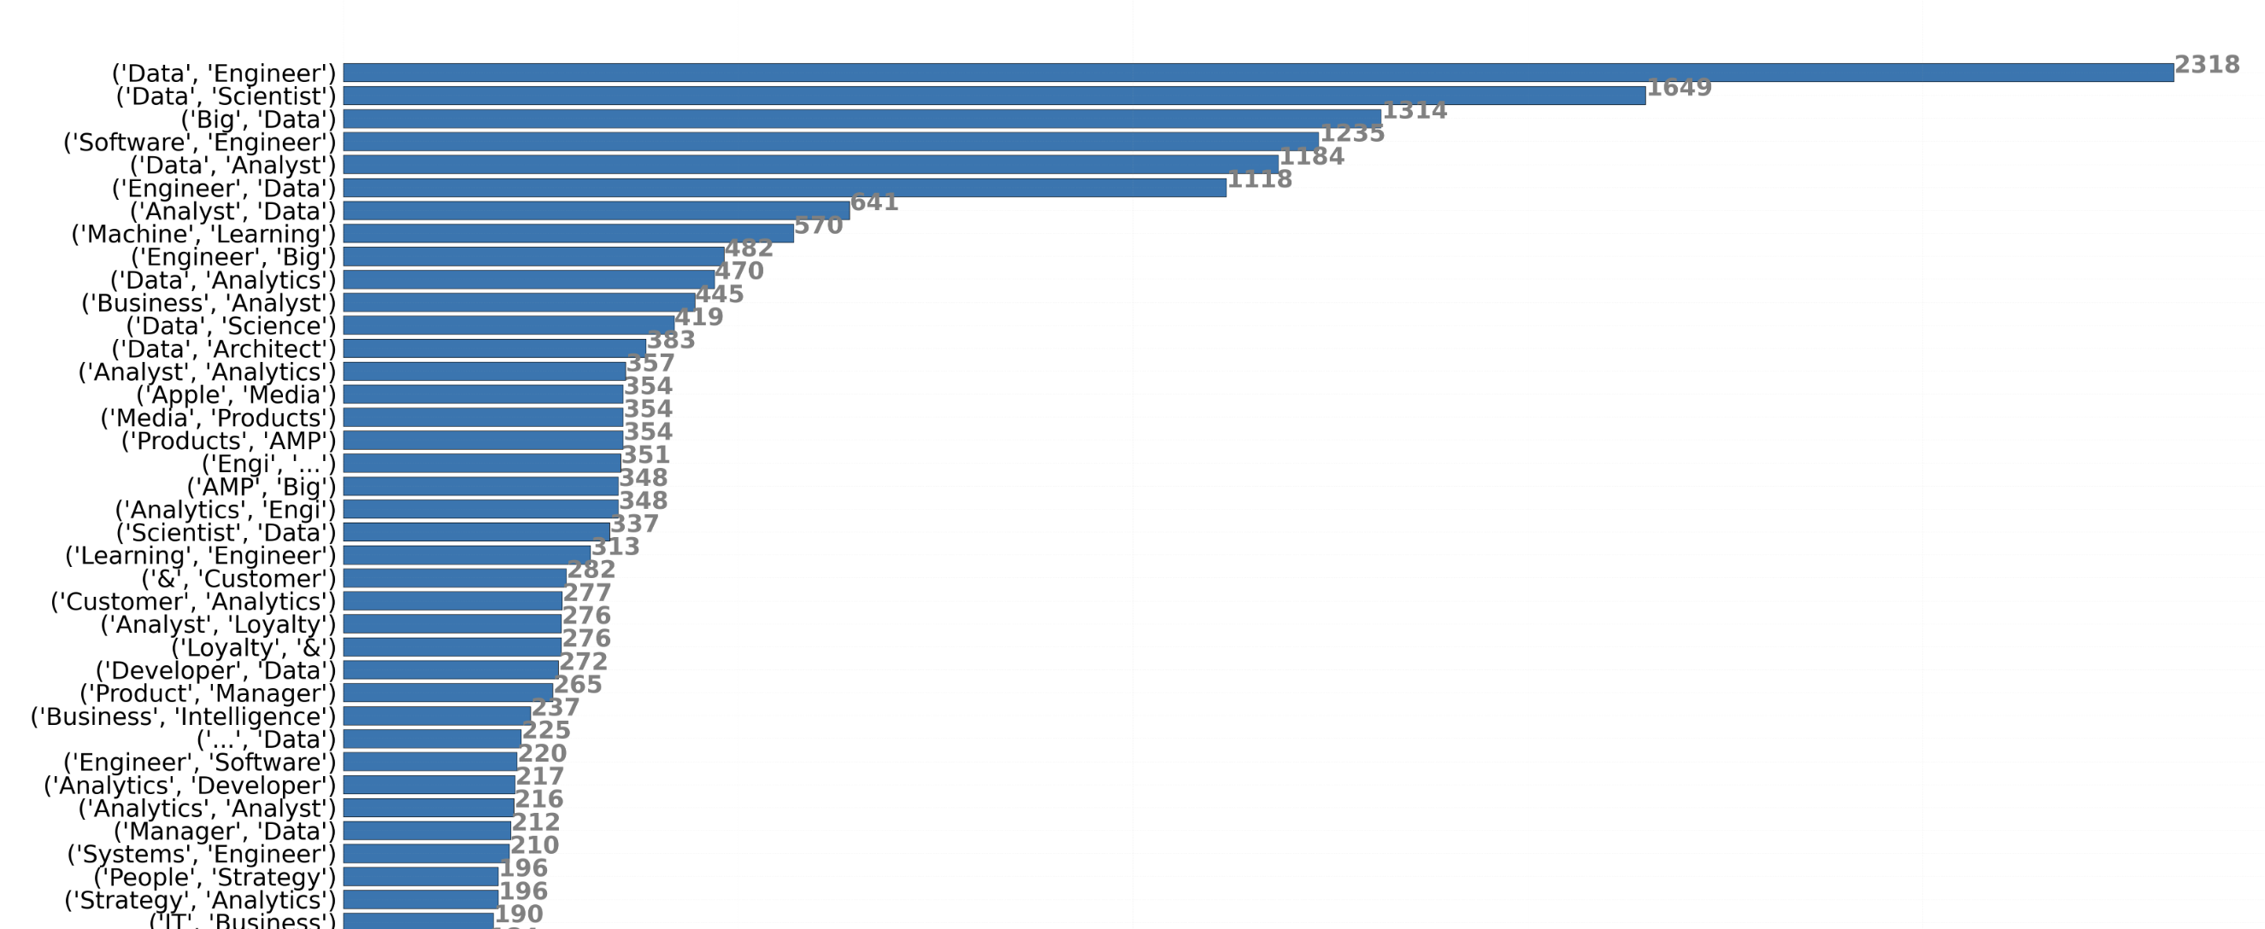
Bigrams Results

Slide 7
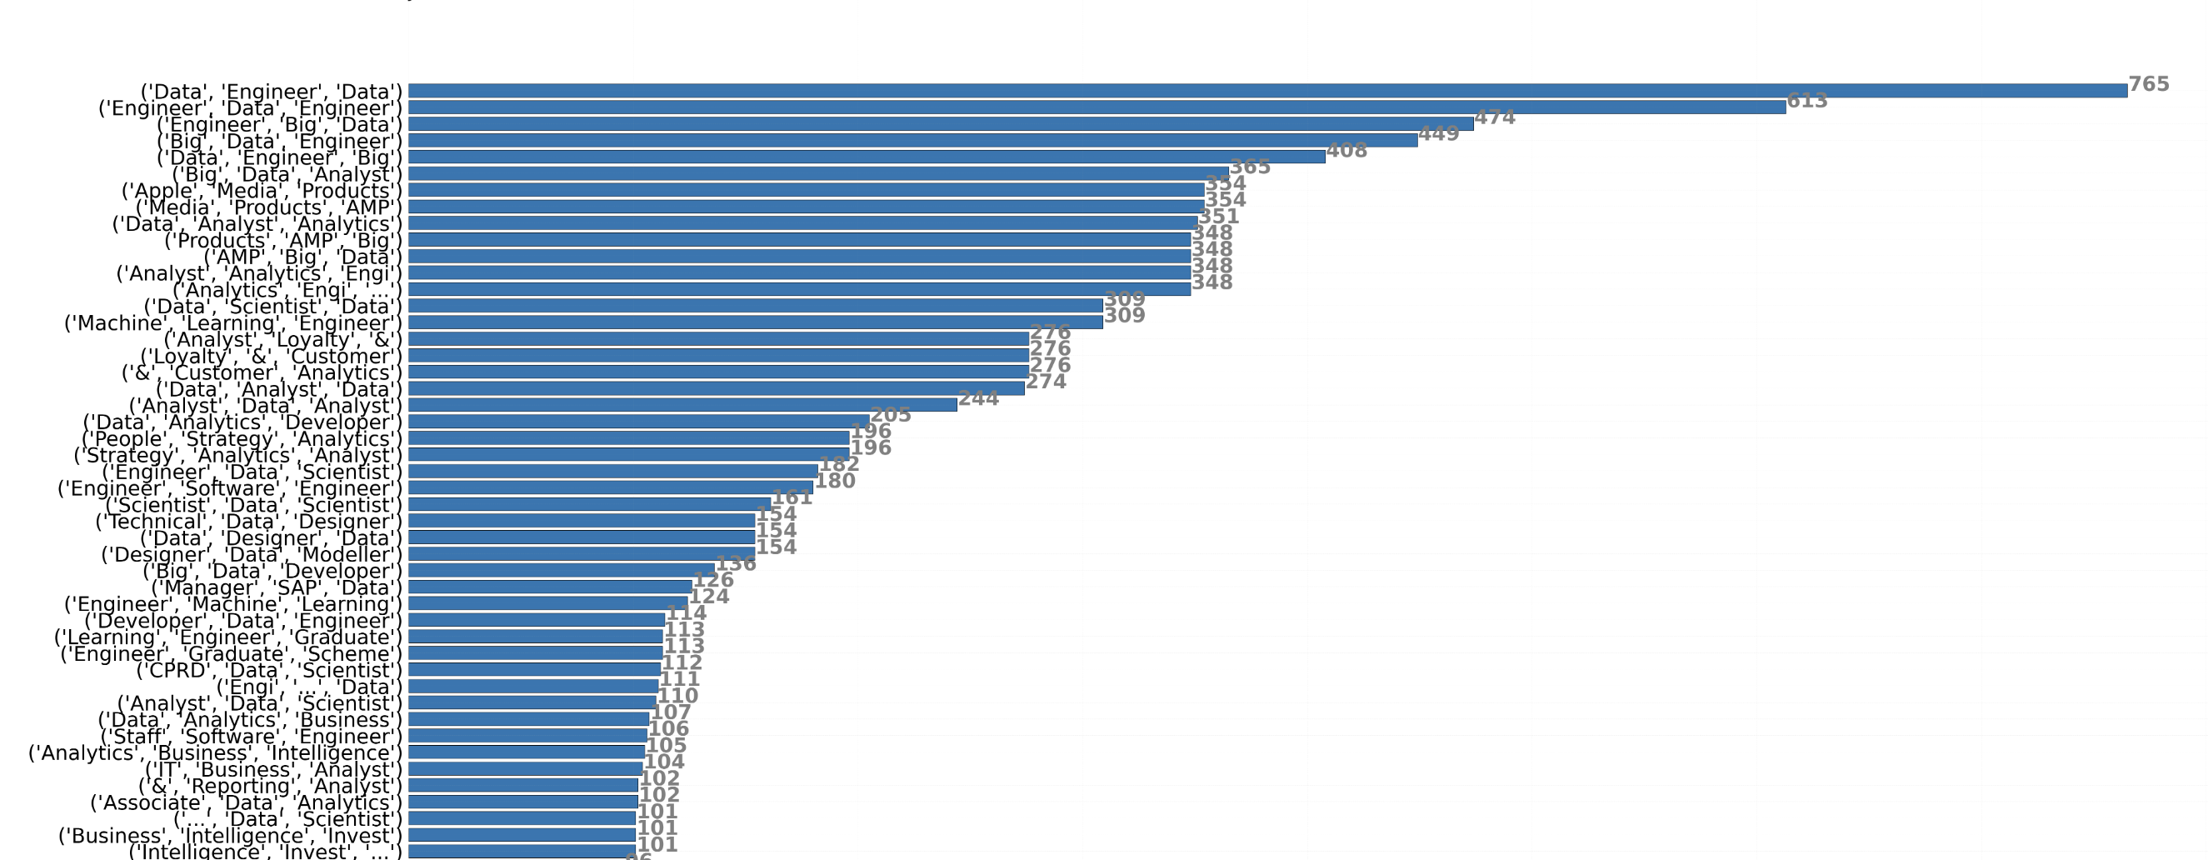
Trigrams Results:

Slide 8
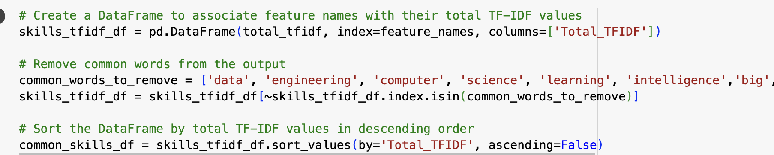
Homogeneous Skill Analysis using TF-IDF
Goal is to identify and rank the most relevant skills across all jobs in the dataset.
We have used TF-IDF to identify important words in a document (Skills Column) by considering both their frequency in the document and their rarity across the entire document collection.
It involves, TF-IDF Vectorization, Sum TF-IDF Values, Get Feature Names, Flatten Array, Create Data Frame, Remove Common Words.
Here, removing common words like data, engineering etc., is to obtain the effective result.

Slide 9
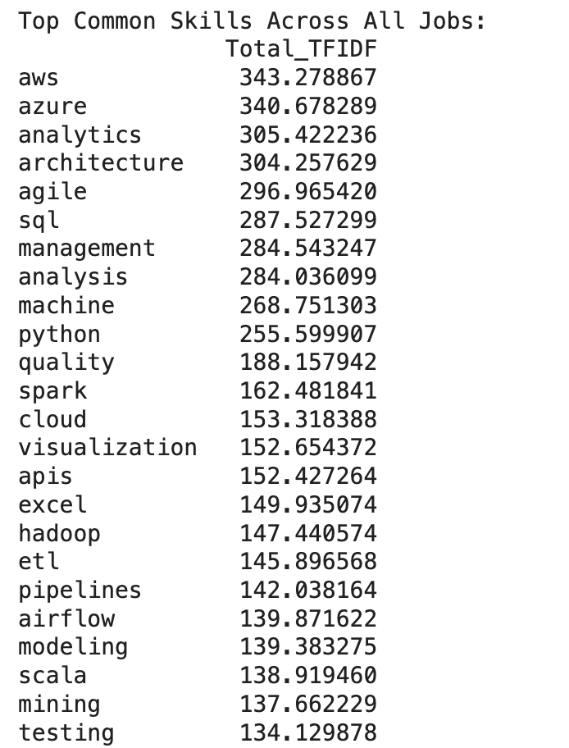
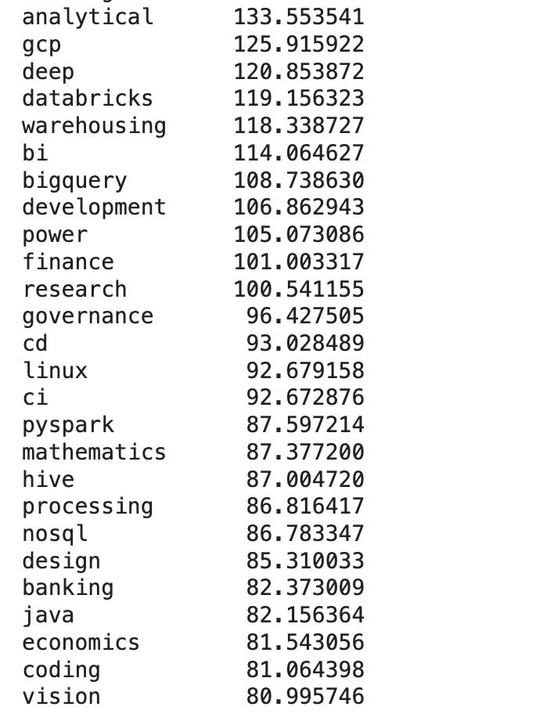
Homogeneous Skills

Slide 10
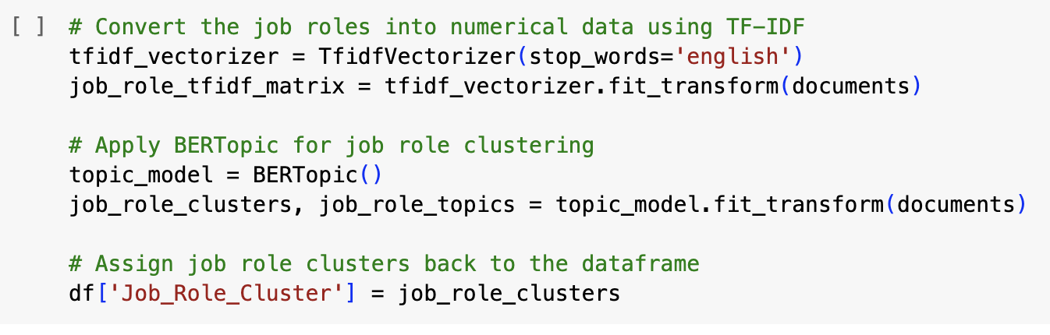
Level of Skill Competence for each Big Data Family
We have used BERTopic a topic modeling technique, which uses BERT (Bidirectional Encoder Representations from Transformers) to perform topic modeling for text and clustering of textual data.
It automatically cluster and identify prevalent job role patterns within our dataset.
This model does not need any pre-processing of data like removal of stopwords, punctuations etc., as it comes with the pre trained word embeddings.
It captures semantic meaning of a word in the sentence rather than rely on the bag of words.

Slide 11
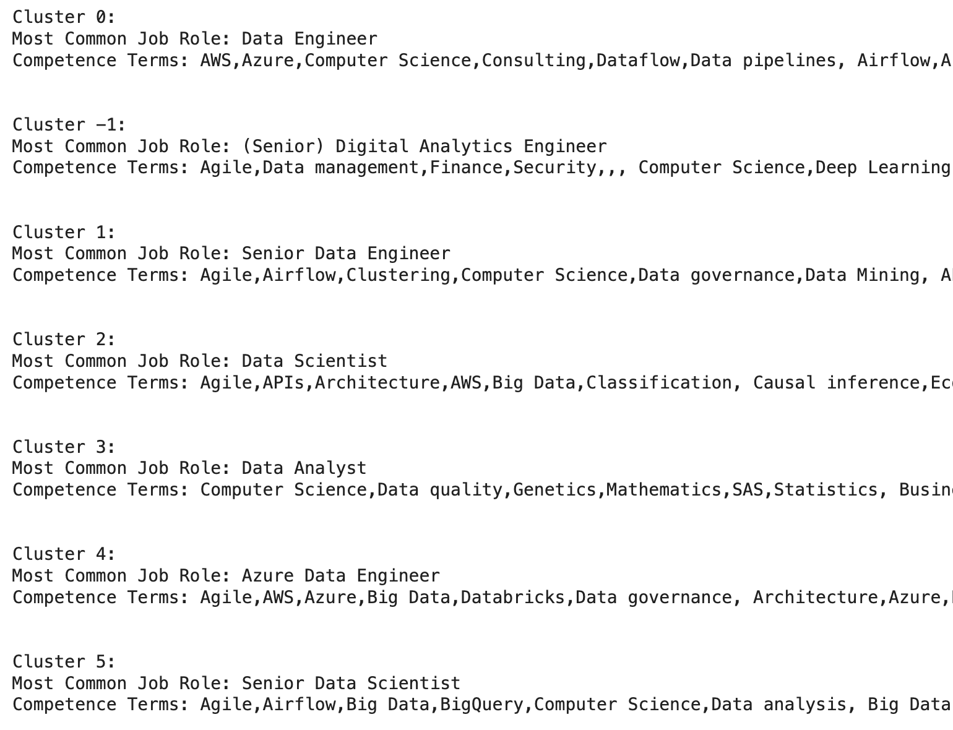
Level of competence for each cluster

Slide 12
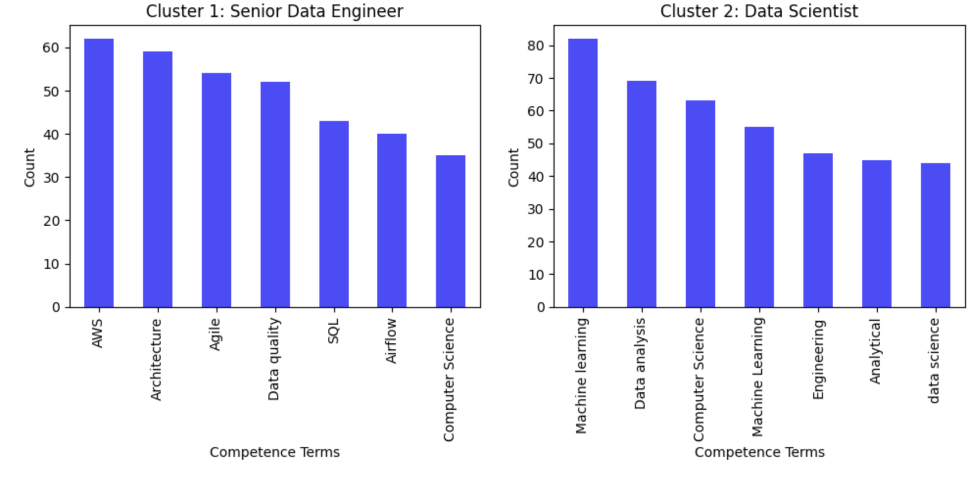
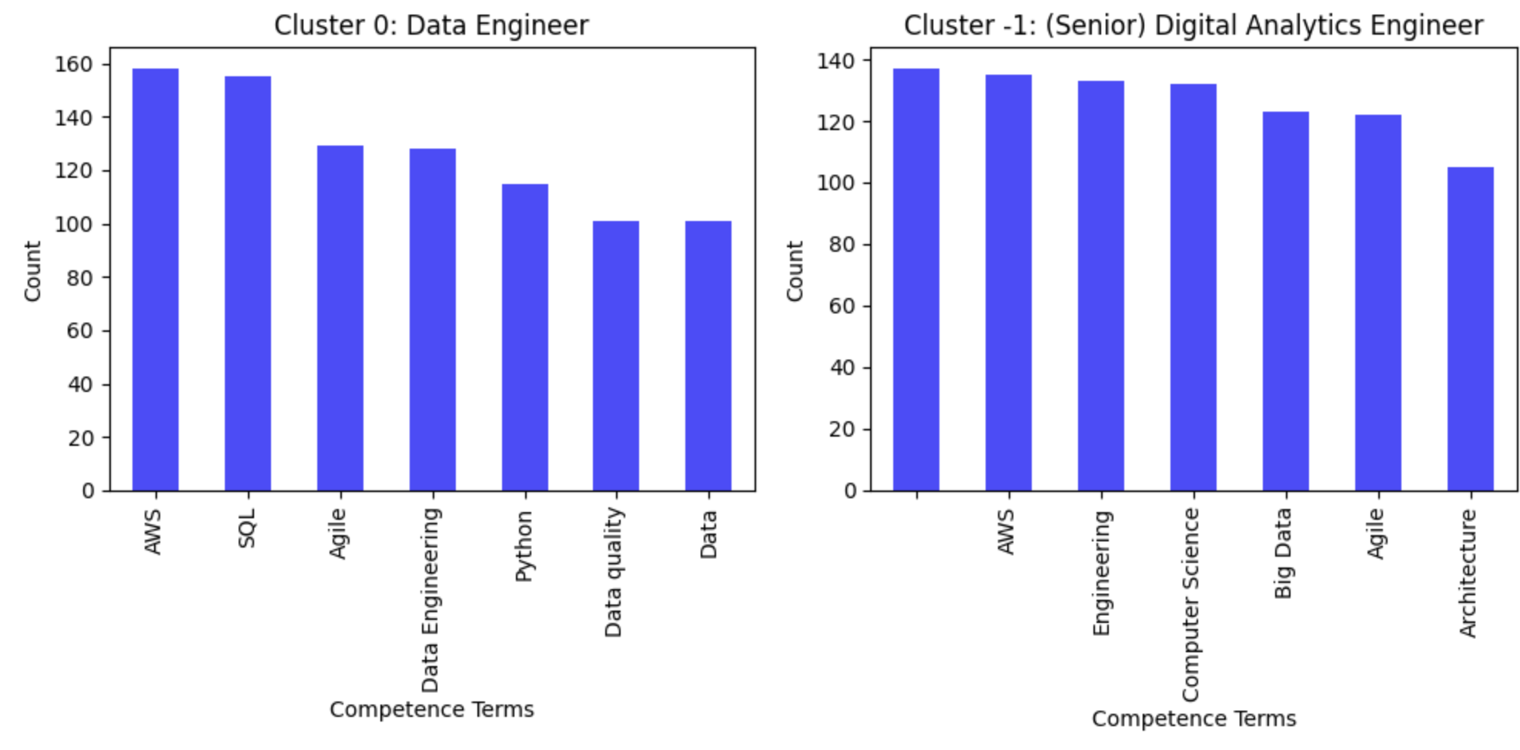
Bar chart representation
We have shown the top seven skills that are highly required (preferred) for each cluster.
We have assigned most common job roles within each cluster, providing insights into the distribution of roles.

Slide 13
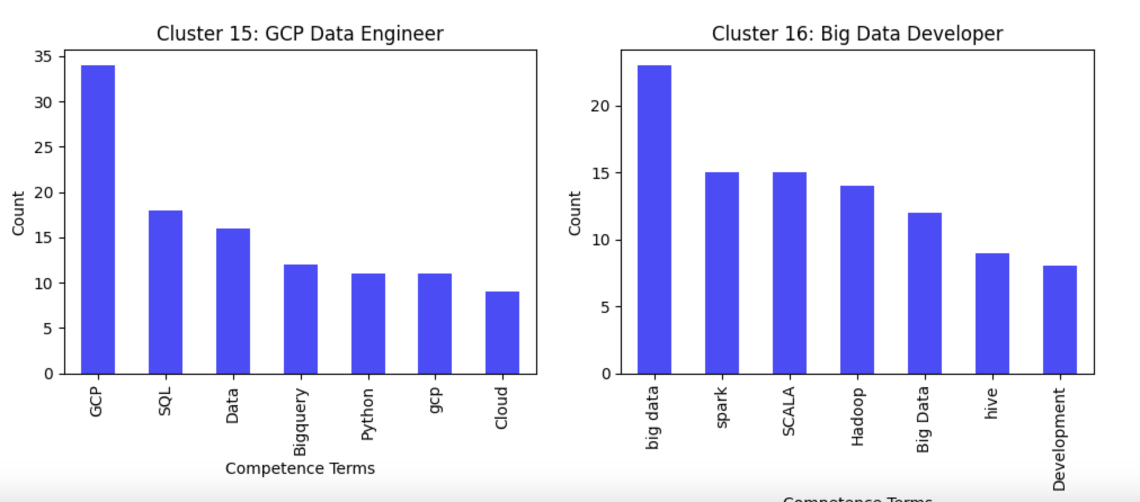
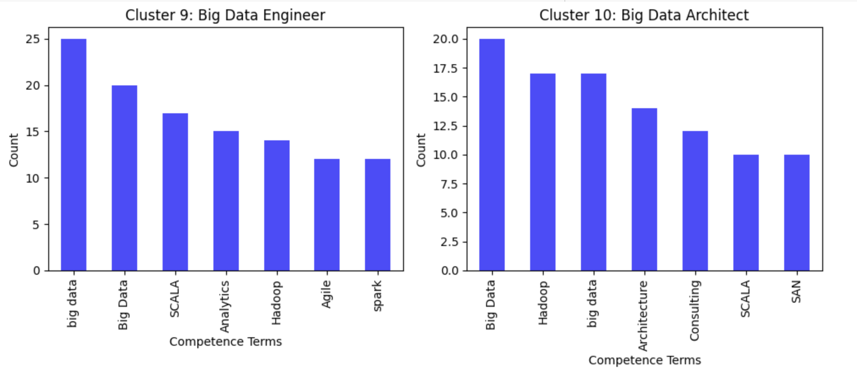

Slide 14
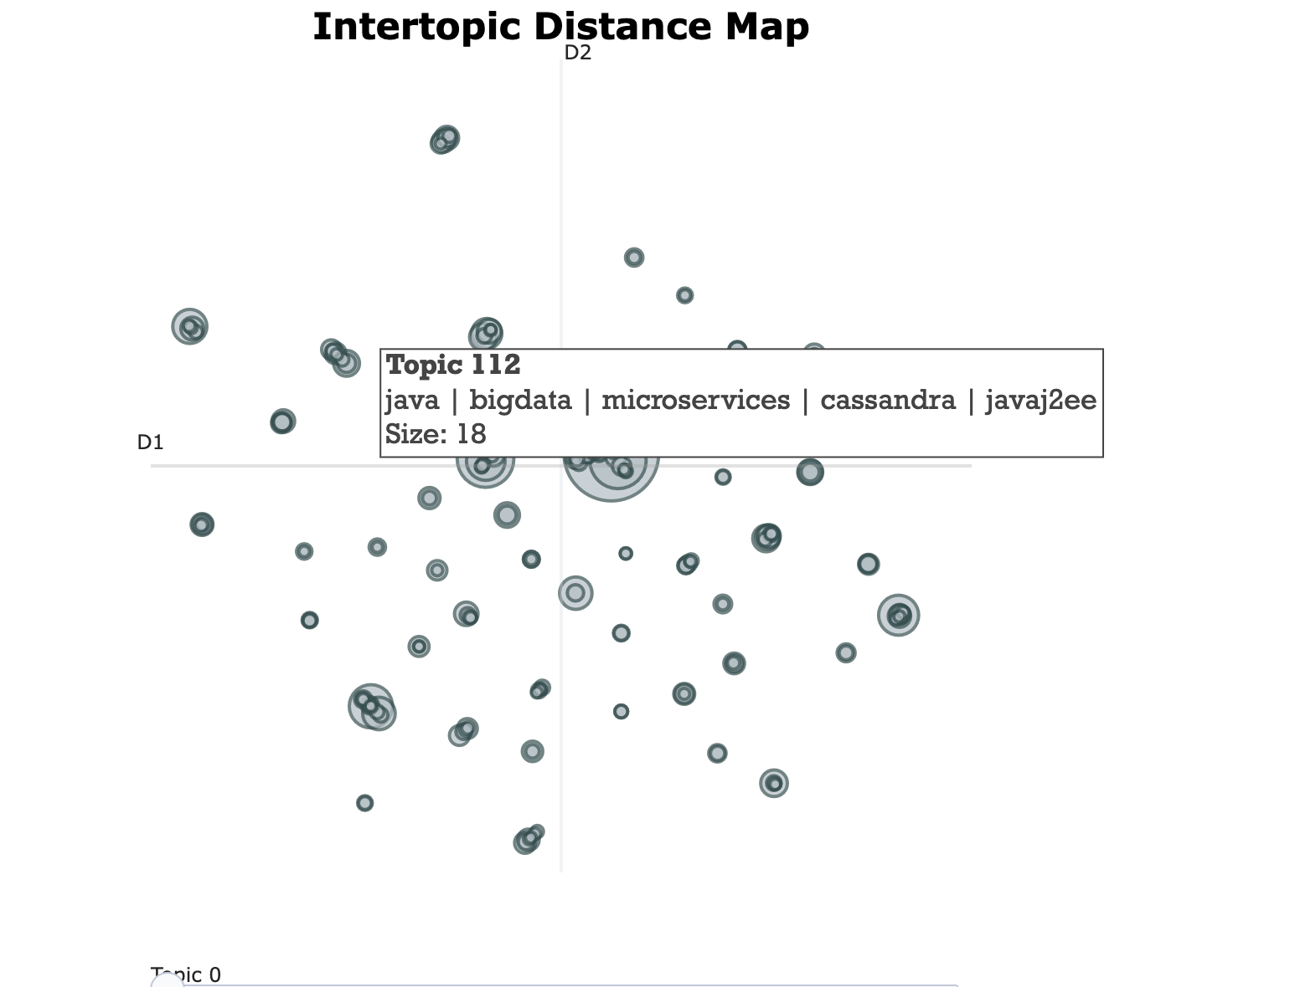
Intertopic distance graph
Intertopic distance graph is used to visualize the distance between different clusters. Each cluster is represented as a point or dot.

Slide 15
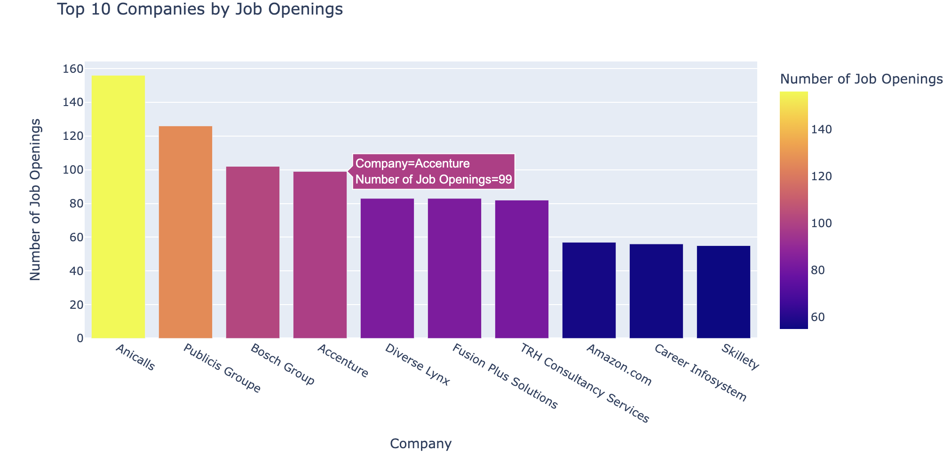
Companies with most Job openings

Slide 16
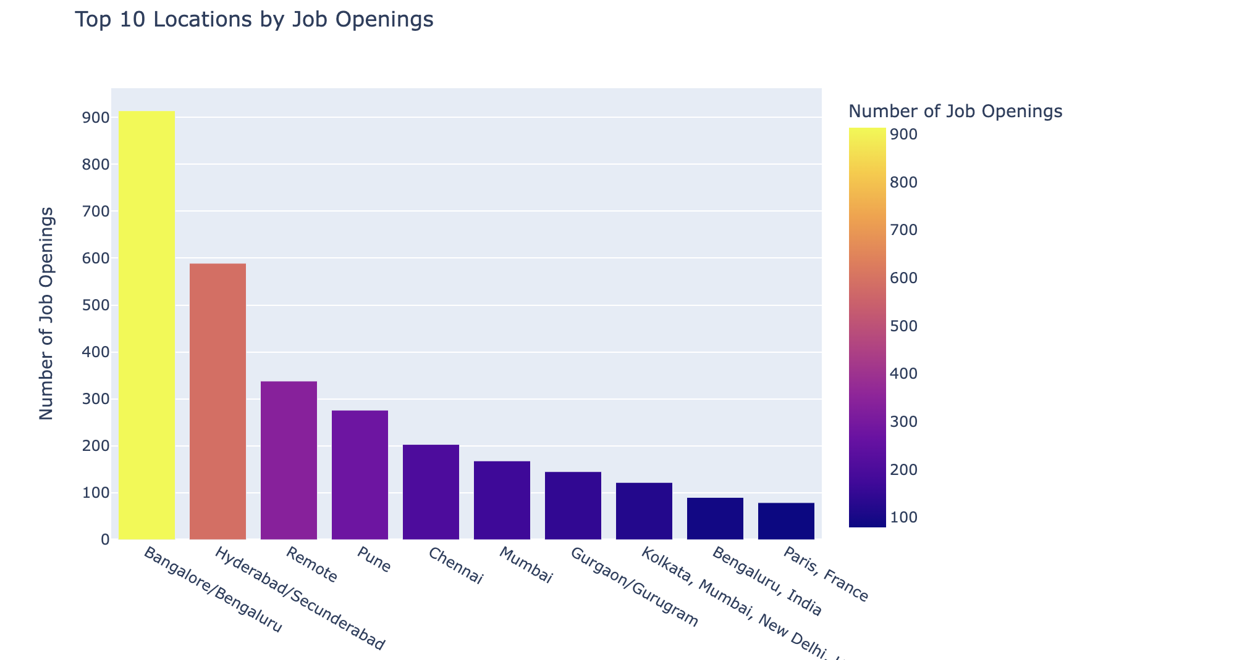
Top 10 locations with most no of Job Openings

Slide 17
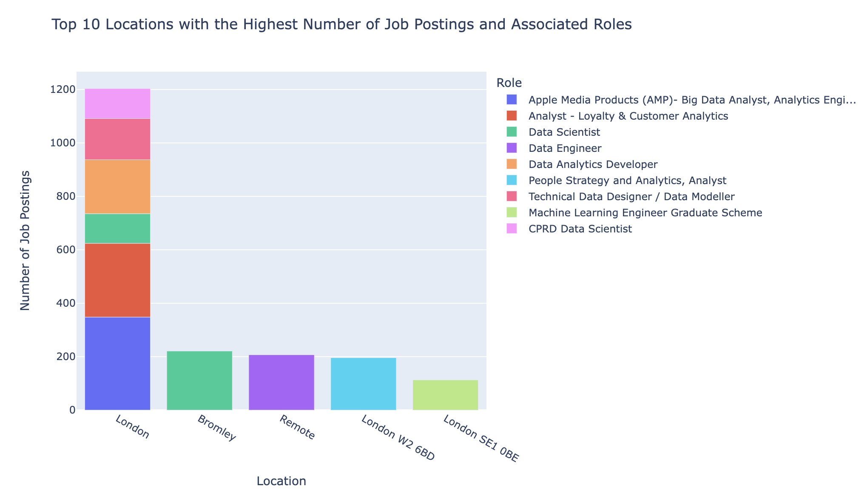
Top 10 Locations With Highest no of Job Openings And Its Associated Roles

Slide 18
Challenges
Collection of live big data related jobs is a big challenge. Almost all the websites blocked us from web-scraping.
With the help of Apify API, we were able to collect 10k jobs from Indeed, Dice and Glassdoor. Another 11k from Naukari and Kaggle.
The Idea of BERTopic is itself a huge challenge, We came across this topic in a youtube video from Dr. William.

Slide 19
Limitations
A notable drawback of employing BERTopic is the considerable time it consumes for document processing. This challenge intensifies with the expansion of the dataset size, making it increasingly demanding.

Slide 20
THANK YOU

